Slide 1


Fractional Knapsack Visualizer
Bridging Algorithm Design and Interactive Learning
Presented by:
Parth
Raj
Dhruv
Akhtar
Meet
Objective: A web-based tool to visualize the Greedy approach to the Fractional Knapsack Problem.

Slide 2
The Problem Definition
What is the Fractional Knapsack Problem?
Given a set of items, each with a weight (w) and a value (v).
We have a knapsack with a maximum capacity (W).
Goal: Maximize the total value in the knapsack.
The "Fractional" Twist: Unlike the 0/1 Knapsack (Dynamic Programming), we can take parts of an item.
Example: If an item is a 10kg bag of gold dust, we can take 3.5kg of it.

Slide 3


The Greedy Strategy
Why it works: The optimal solution is found by making the locally optimal choice at each step.
Calculate Ratios: For every item, calculate the value-to-weight ratio:
Sort: Arrange items in descending order based on this ratio.
Fill: Take as much of the highest-ratio item as possible. If the sack isn't full, move to the next best item.

Slide 4
Technical Architecture
A Modular Approach: We divided the project into three distinct layers to ensure clean, maintainable code:
Component
Responsibility
File
Algorithm
Core logic, sorting, and step-by-step calculation.
algorithm.js
Visualizer
DOM manipulation and CSS animations for the "Sack."
sack.js
UI Controller
Event listeners, user inputs, and simulation speed.
ui.js

Slide 5
Core Logic (algorithm.js)
How the math happens:
Cloning & Enrichment: We map the input data to include the ratio property.
The Sorting Engine: Items are sorted descending by ratio.
State Tracking: The algorithm doesn't just return the result; it records a Step History.
Why? This allows the UI to "replay" the algorithm's decisions one by one rather than just showing a final number.

Slide 6


Visualizing the "Sack" (sack.js)
Making the abstract concrete:
Dynamic Filling: The height of each item in the visual "Sack" is proportional to the total capacity:
Animation Pipeline: * Items are cloned from the "Pool."
They "fly" toward the sack using CSS transitions.
Colors change based on whether an item was taken Fully (Green) or Partially (Yellow).

Slide 7
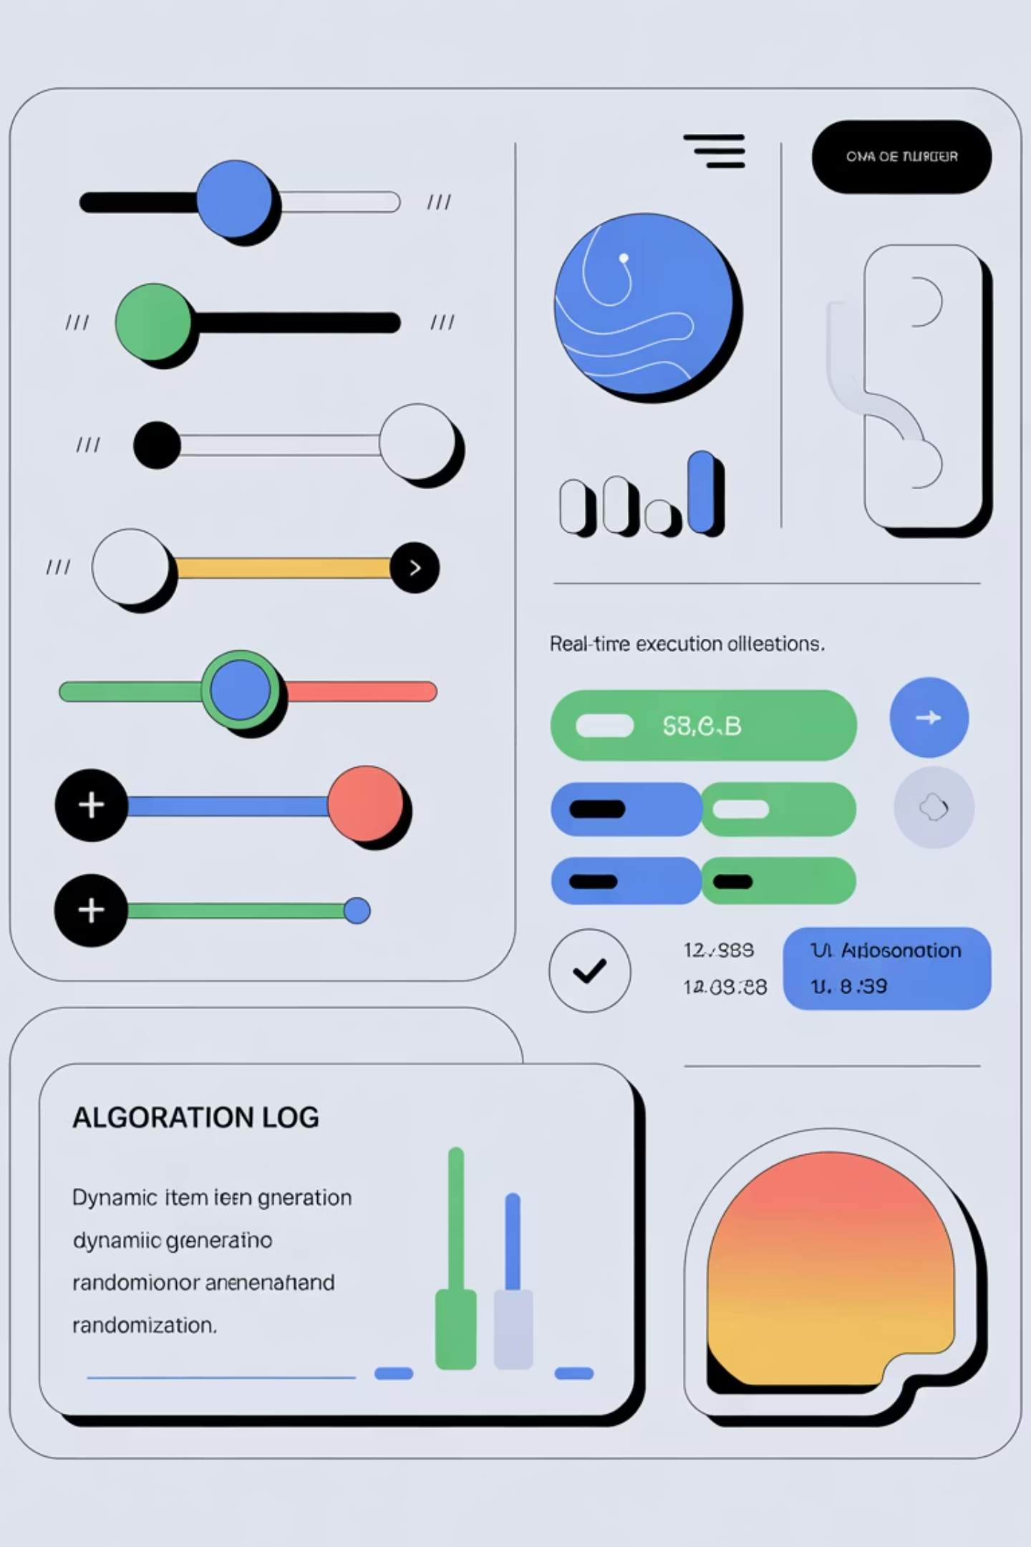
User Experience & Controls (ui.js)
Putting the user in the driver's seat:
Dynamic Item Generation: Users can choose how many items to test.
Real-time Logging: An execution log explains why the algorithm is making specific choices (e.g., "Fits completely" vs "Fits only 40%").
Speed Control: A slider allows users to speed up the simulation (up to 4x) or slow it down to study the steps (0.25x).
Randomization: A "Random" button helps test edge cases quickly.

Slide 8
Key Features & Innovation
Interactive Simulation: It’s not just a calculator; it’s an educational tool.
Responsive Feedback: The visualizer handles "Not Taken" states by fading out items that didn't fit.
Precision Stats: Real-time updates for:
Current Total Value
Current Weight / Max Capacity
Percentage Fill of the Knapsack

Slide 9
Thank You!

